Slide 1
The Application Module
(Section 1)

Slide 2
Ingredients of an application module

Slide 3
Commonly used application module configuration properties
Property | Description | Default Value
jbo.ampool.initpoolsize | The number of application module instances created when the pool is initialized. | 0
jbo.ampool.minavailablesize | The minimum number of available application module instances that the pool monitor should leave in the pool during the resource cleanup operation. | 5
jbo.ampool.timetolive | How long to wait before the application module in the pool becomes a candidate for removal. | 3600000 ms
jbo.dofailover | Enable eager passivation of the pending transaction state each time an application module is released to the pool in managed release (stateful) mode. This needs to be turned ON for high availability. | false
jbo.max.cursors | The maximum number of cursors the business components may have open. The framework will clean up free JDBC statements as the number of cursors approaches this number. | 50
jbo.load.components.lazily | Determines whether to load components definitions lazily. | false
jbo.recyclethreshold | Maximum number of application module instances that attempt to preserve session affinity for the next request. | 10

Slide 4
Commonly used application module configuration properties
Property | Description
jbo.txn.disconnect_level (default : 0) | This mode controls how the application module is disconnected from the client at the end of a request, typically used in conjunction with connection pooling. If jbo. txn.disconnect_level = 0, then the framework removes the view object and its row set when the application module is disconnected from the client and recreates the same for next request. If jbo.txn. disconnect_level = 1, then the framework stores the state of the view object and row set in memory closing the corresponding JDBC objects, which is faster and recommended. In other words jbo.txn.disconnect_level = 1 instructs the framework to manage the partially fetched JDBC ResultSets in memory rather than passivating their state.

Slide 5
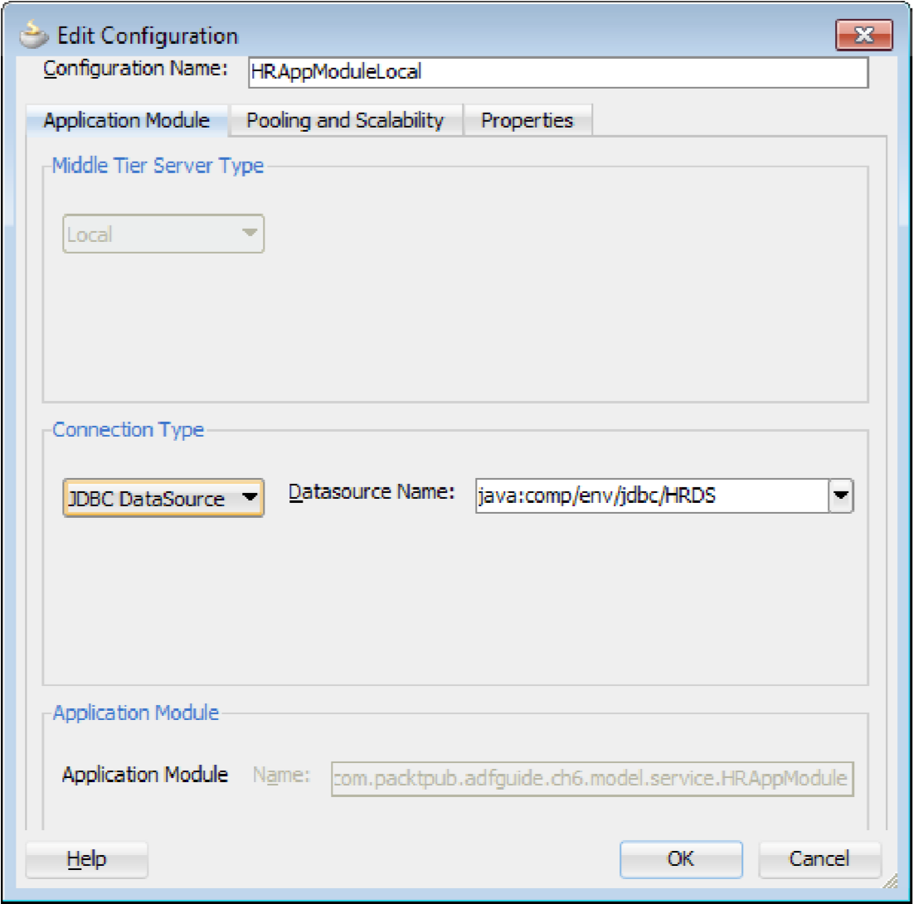
Modifying the JDBC data source name for an application module

Slide 6
Sharing of application module data
An enterprise application often uses seed data as master data in business data capture screens. An example might be, the use of currency codes in a list of values components displayed in various data capture screens. It makes sense to cache the data and share it across multiple user sessions or share it across requests for a specific session.
application level
session level

Slide 7
Runtime behavior of shared application modules
A Session scoped shared application module is created as a nested application module under the root application module at runtime. Its data is shared only within the same application module hierarchy where it has been added. In other words, it is not shared across distinct root application modules.
An Application scoped shared application module is shared across sessions. A view object in an application scoped shared application module uses multiple iterators on top of a single row set for serving multiple clients.

Slide 8
Query execution for a shared view object
When you call executeQuery() on a view object that is added to a shared application module, the framework will delegate the call to refreshCollection to reuse the possibly existing query collection.
ViewObjectImpl vo = (ViewObjectImpl)findViewObject("Departments"); vo.forceExecuteQueryOfSharedVO();

Slide 9
Shared query collection cache management
The query collections in a non-shared application module are weakly referenced. On the other hand, the shared query collections, which reside in the shared application modules, are stored in query collection pools and are strongly referenced. Consequently, they may stick around for the lifetime of JVM (Java Virtual Machine) and may even outgrow the heap if left unchecked.
The ADF Business Components framework removes the unwanted query collections based on a maximum idle time setting. This feature limits the growth of the cache and removes unused query collections from the memory space.

Slide 10
Shared query collection cache management
Property | Description | Default Value (in Milliseconds)
jbo.qcpool.maxinactiveage | The maximum amount of time (ms) that a shared query collection may remain unused before it is removed from the pool. | 1800000
jbo.qcpool.monitorsleepinterval | The time (ms) that the shared query collection pool monitor should sleep between pool checks | 900000

Slide 11
The maximum weight of the query collection pool
protected void initSharedQCPoolProperties(QCPoolProperties qcProp){
qcProp.setMaxWeight(10000);
}
protected double getQueryCollectionWeight(QueryCollection qc){
double weight;
weight = super.getQueryCollectionWeight(qc);
// your algorithm...
return weight;
}

Slide 12
Consuming a shared application module
To consume a view object defined in a shared application module, you will need to do the following:
Package the project that holds the shared components (the shared application module) as an ADF Library JAR
To consume this Library from another project, add it as a dependent to the consumer project and reuse the components
You can later use this view accessor for defining the LOV or for defining validation. In the consumer model project, double-click the entity object or view object on which you want to define the view accessor.

Slide 13
What happens when a client creates an application module instance?
String amDef = "com.fanousoft.adftrain.model.service.HRServiceAppModule";
String config = "HRServiceAppModuleLocal";
ApplicationModule am = Configuration.createRootApplicationModule(amD ef, config);

Slide 14
What happens when a client creates an application module instance?
Client
Configuration
PoolManager
SessionCookie
ConnectionStrategy
ApplicationModuleImpl
:
:
:
:
:
:
createRootApplicationModule
findPool
createPool
create
ApplicationModulePoo
:
ApplicationModulePool
createSessionCookie
SessionCookie
useApplicationModule
useApplicationModule
instantiateResource
createApplicationmodule
createRootApplicationModule
ApplicationModule
ApplicationModule
ApplicationModule
ApplicationModule

Slide 15
The lifecycle of an application module
Application module pooling logic will try to identify the client using the Session Cookie that is carried along with the request. If it is a web client, a session cookie is generated from the session identifier information present in the HttpRequest object.
If this is the first request from the client, then the default application module pool implementation will try to allocate an available unreferenced instance from the pool to the client. If this is not the first time that the client has requested an application module, then application module pool will try to identify the instance used previously and will allocate the same if it is available.
If all the instances in the pool are in use and the numbers of instances in the pool are fewer than the maximum pool size and the recycle threshold for the application module pool is not reached, then the application module pool will create a new instance and allocate the same to the client.
If the pool size is equal to the maximum pool size or recycle threshold is reached and there are idle instances available in the pool, then the application module pool chooses the least recently used one from the pool, passivate its state, and activate the same for servicing the current request.
If all instances are in use and the pool size is equal to the maximum pool then the resource application module pool will throw a check-out failure exception to the caller.

Slide 16
The lifecycle of an application module
ApplicationModuleImpl::activate(Session session
ApplicationModuleImpl::applyPersonalization()
ApplicationModuleImpl::afterConnect
ApplicationModuleImpl::prepareApplicationModuleSession(Sessi on session): can be overridden to initialize the application module session that should not be re-executed when the application module is reconnected.
ApplicationModuleImpl::prepareSession(Session session): when an application module is first created, and each time when an application instance is associated with a user session.
ApplicationModuleImpl::prepareForActivation(Element amNode
ApplicationModuleImpl::activateState(Element parent)
ApplicationModuleImpl::afterActivation(int activationMode):
ApplicationModuleImpl::activateConnectionState(Element parent)Generally, developers may override this method to use custom approaches for restoring state information.

Slide 17
The lifecycle of an application module
After serving the request the framework will check in the application module instance back to the pool. The release mode property (RELEASE_MODE) set for the application module configuration decides how this instance needs to be released back to the pool. The possible options are as follows:
Stateful: This is the default release mode (also known as the managed mode). In this mode, the application module pool will allocate the same instance of the application module for the same data control if it is available at the moment. If the previously used application module is busy or unavailable, then a different application module will activate this data control's state.
Stateless: This mode is also known as unmanaged mode. In this mode no state is preserved across requests from the same client. This is more of a performant than the other two modes because of its stateless nature, however this may not be an ideal option if the transaction state spans across multiple requests.
Reserved: This guarantees that the application module will remain sticky for a data control (client) and the same instance will be available throughout the session. This is not recommended for a web application as it adversely affects the scalability of the system.

